Slide 1

Project Tablet Pilot
Survey result

Slide 2
We reaching the last milestone: The tablet test launch
Summary

Slide 3
Overview
The survey was conducted to assess tablet pilot based on the following indicator category:
Ease-of-use
Functionality
Efficiency
User experience

Slide 4
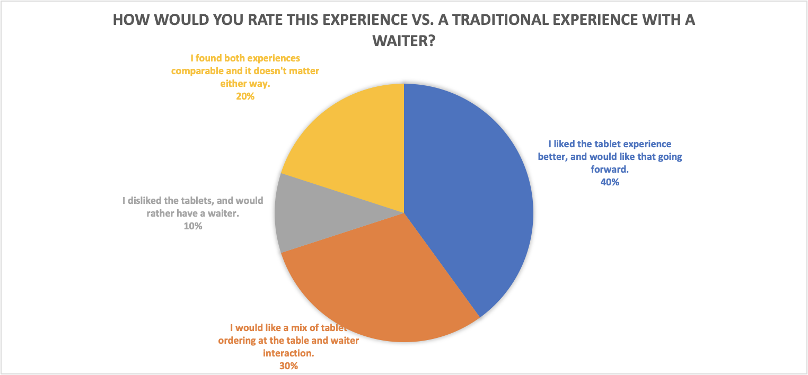
Findings
According to the survey,
customers accept the tablet experience,
but still need some degree of customization

Slide 5
Next Steps
Issue:
14 people (28%) said the kitchen prepare their customized order incorrectly?
Solution:
checking with the chief staff what reason cause thing are wrong.

Slide 6
Next Steps
Issue:
42 people (84%) did not sign up for birthday club.
Solution:
Add the sign up advertising on the promotion page.

